Slide 1

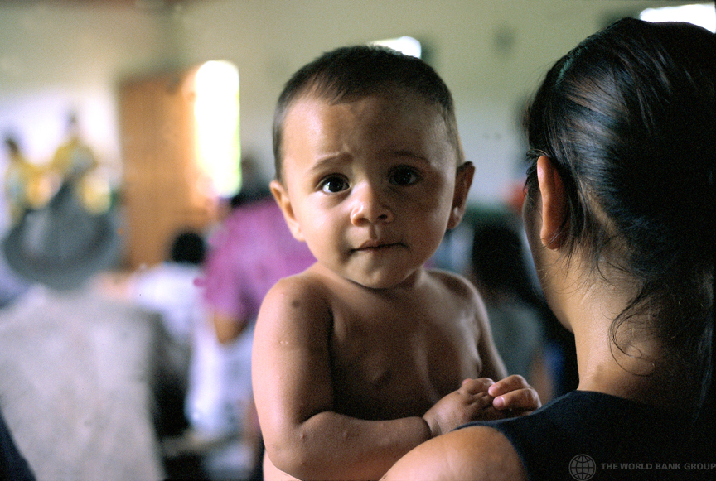
Cost Implications of the Early Childhood Development Support program (PADIN) in Ceará, Brazil Alaka Holla Samuel Fishman Kamila Nascimento Yilin Pan April 27, 2021
Photo: © Julio Pantoja / World Bank

Slide 2






Agenda
What are the goals of the study?
Why should we cost out PADIN (and probably Crianca Feliz)?
How did we collect cost data for PADIN?
What have we learned about PADIN based on data available?
What is still missing and what are the next steps?

Slide 3
Agenda
What are the goals of the study?

Slide 4
Goal 1: Estimate costs
Accurate total & unit costs
Financing source
Federal
State
Cost drivers
Personnel
Municipal
Transport
Support
Families
Variation
Impact
Implemen-tation
High risk groups

Slide 5
Goal 2: Set up a system for estimating costs
Standardize categories
Pre-program budgeting
M & E
Program reporting
Include fields relevant for costing
Comparisons of programs
More accurate cost forecasts

Slide 6
Agenda
Why should we cost out PADIN (and probably Crianca Feliz)?

Slide 7
Accurate cost data can tell us a lot
Cost economy
Cost efficiency
Benefit-cost ratio, rate of return
Cost-effectiveness
How much did/will program cost?
How much will it cost at scale?
What are the largest drivers of cost?
What is the cost per beneficiary?
Do benefits outweigh costs?
What is the least expensive way to achieve a certain impact?

Slide 8
Agenda
How did we collect cost data for PADIN?

Slide 9
Multiple sources of data….
Budgets
Aggregated expenditure at the state level; monthly budgets at the municipality level
M & E data
Number of supervisors and home visitors (ADIs) by municipality
Field visits
Alaka and Sam conducted the field visit in June 2019
Interviews
Kamila interviewed supervisors at the municipalities and had several rounds of follow-up interviews
Surveys
Detailed info on personnel, training, transportation etc. by municipality
Notes:
We reviewed and collected multiple sources of data

Slide 10
…from 32 municipalities
Municipalities in Ceara
[60]
PADIN
[36]
PADIN & Crianca Feliz
[8]
Crianca Feliz
[16]
Responded to the cost survey
[32]

Slide 11

Cost structure and data availability
Fully counted
Partially counted
Not counted
Salary from municipality + PADIN scholarship
PADIN scholarship
Only include compensation for supervisors and ADIs
Self-reported and inconsistent
Home visits to parents
Community meetings
Program admin.
 | Supervisor | ADIs | Food | Office supplies | Training | Transportation | Facilities | Indirect personnel
Notes:
X-axis represents activities and y-axis represents resources

Slide 12
Agenda
What have we learned about PADIN based on data available?

Slide 13
Cost of PADIN per child per month in Ceará, Brazil (Borne by the municipality in 2018-2019, expressed in Brazilian Real)

Slide 14
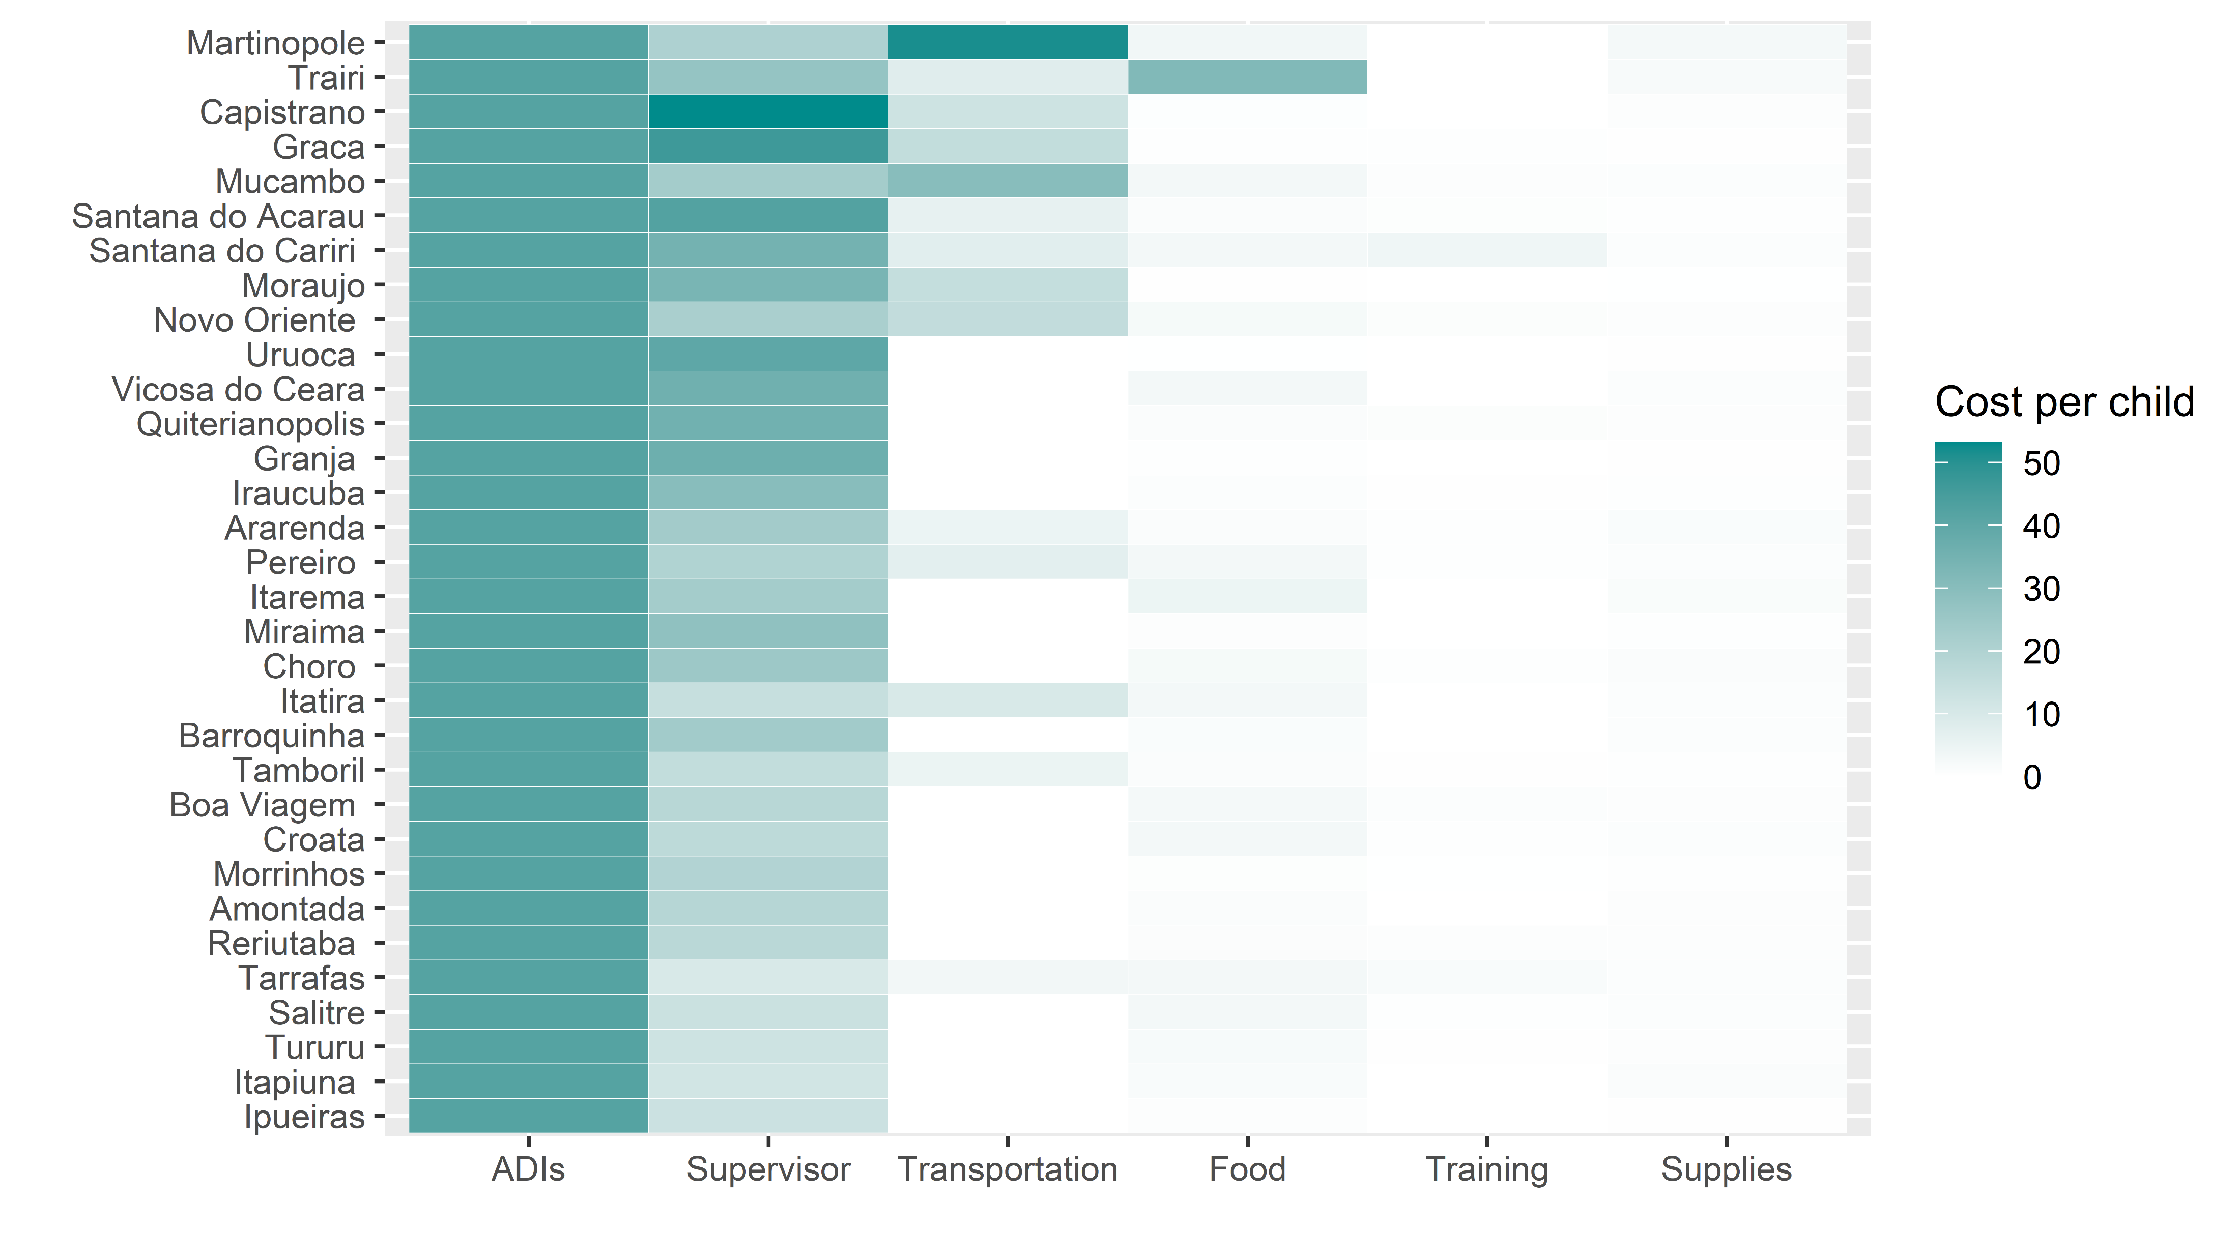
Decomposition into main ingredients
Cost per child per month
Cost per child per month

Slide 15
ADIs’ time
Cost per child per month
PADIN scholarship is the same across the municipalities. For most municipalities, it is the dominating cost.

Slide 16
Supervisor’s time
Four factors that affect the cost of supervisors per child per month
PADIN scholarship: the same across municipalities
What % of supervisor's time is used in PADIN work?
How much is the PADIN supervisor paid from municipality?
Number of children served
Cost per child per month

Slide 17
Variation in cost of supervisor’ time per child per month is driven by both the salary level and % of time devoted to PADIN

Slide 18
Transportation
Martinopole is obviously an outlier that needs to be rechecked: The cost aid is reported to be 517 for each ADI.
Cost per child per month

Slide 19
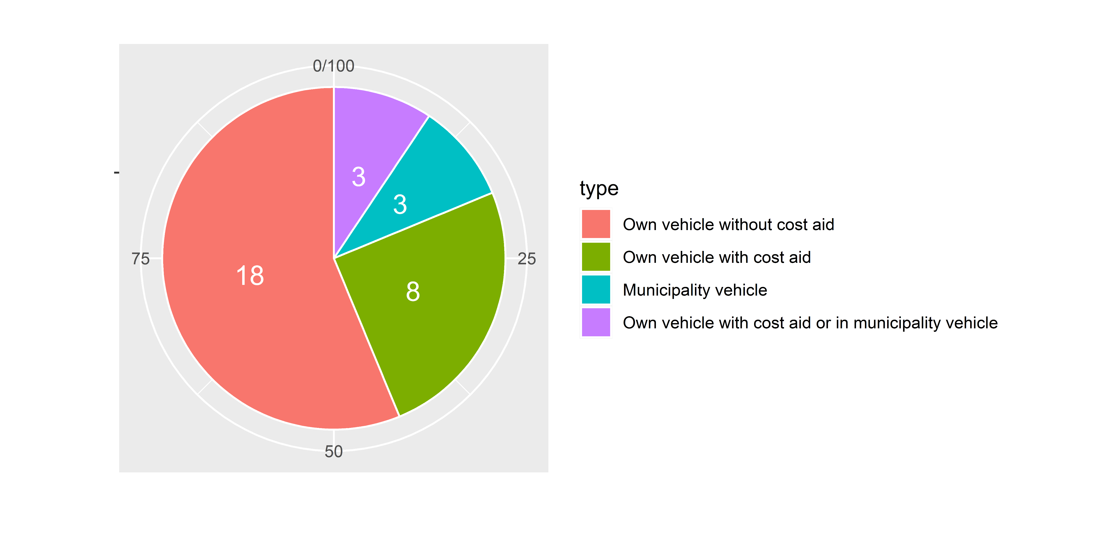
ADIs in 26 municipalities use their own vehicle while those in 6 municipalities use the municipal vehicle

Slide 20
Cost of transportation per child per month: no clear pattern on which way is less costly due to large variation within each group
Outlier: Martinopole
Average within a group

Slide 21
Food for community meetings
Trairi is an outlier that needs to be rechecked.
Food cost is extracted from the municipal monthly budgets. Among the 32 municipalities of interest, only 20 municipalities provided the data.
Cost per child per month

Slide 22
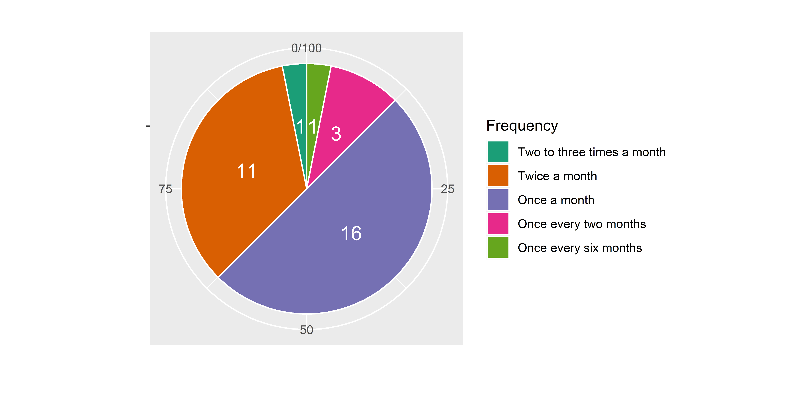
Half of the municipalities provided community meetings once a month, while a third twice a month

Slide 23
Training
Cost per child per month
Training cost seems to be minimal compared to other categories, but it might be due to the fact that it only includes compensation for supervisors and ADIs.
Compensation for trainers, cost of facilities and materials have not been accounted for.

Slide 24
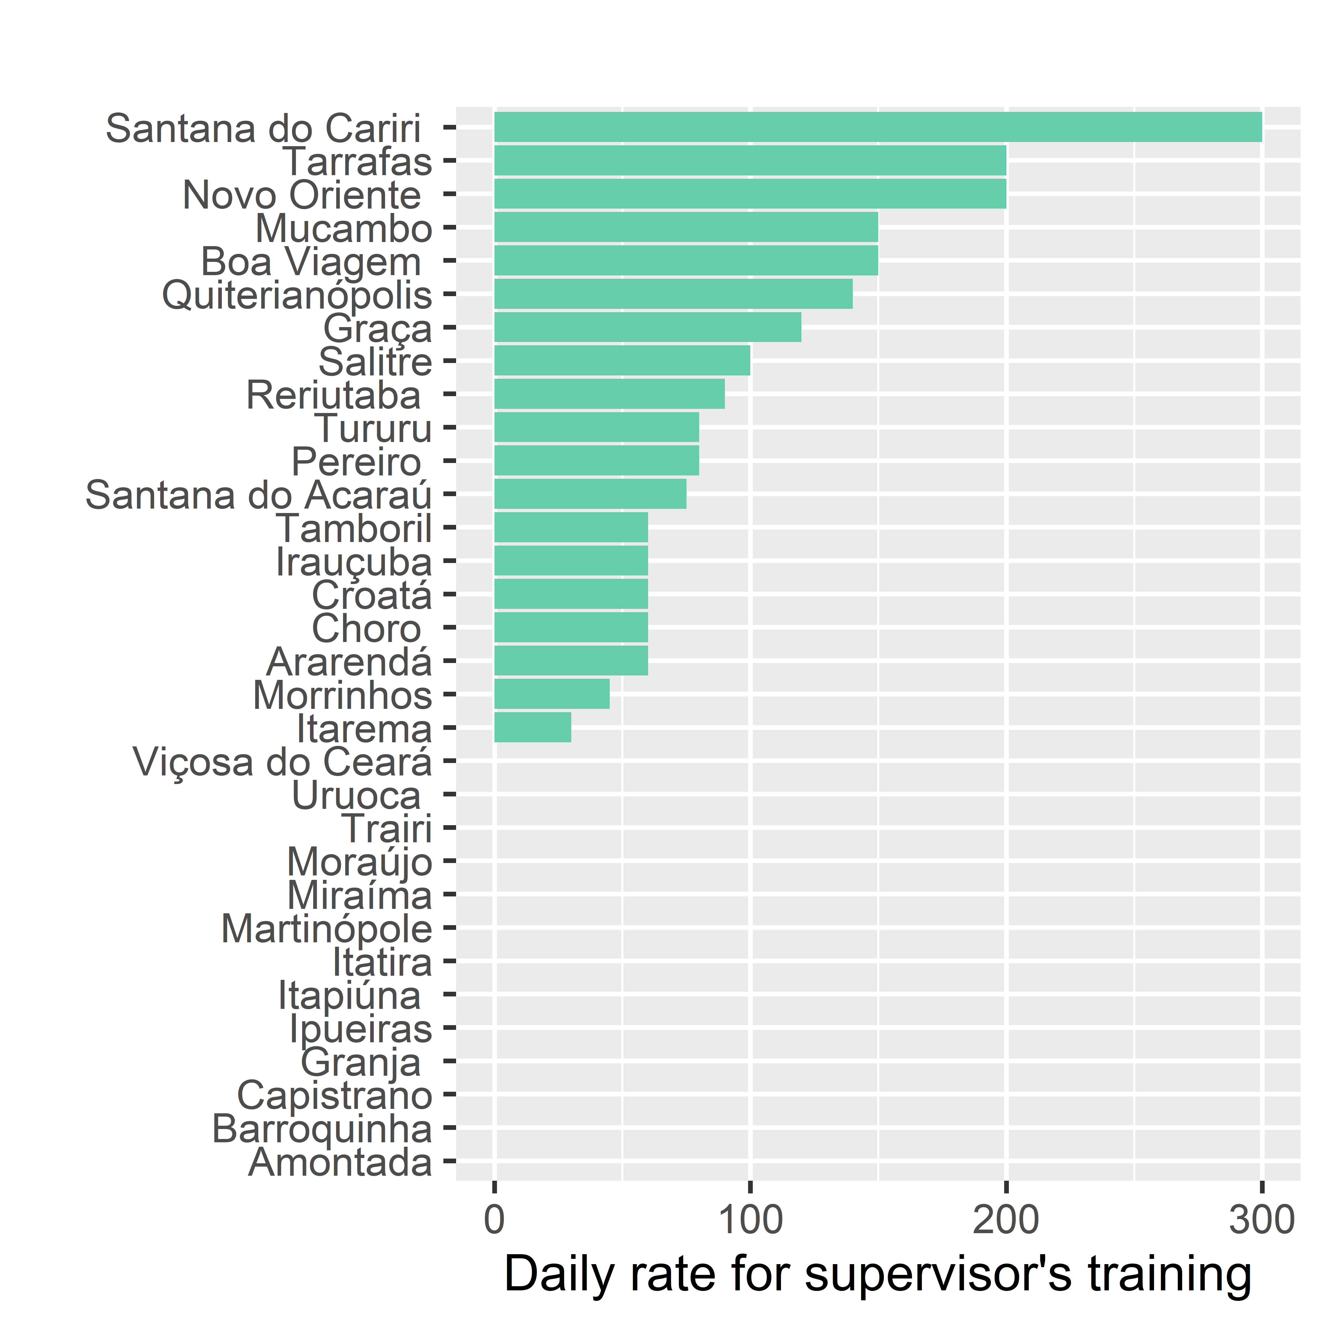
Supervisor’s training
Initial training is uniform across municipalities (5 days)
Ongoing training is various across municipalities.
Each dot is a municipality

Slide 25
Agenda
What is still missing and what are the next steps?

Slide 26
What information is missing?
Missing
Training: Cost of organizing the training
Facilities
Indirect personnel (e.g., Nurses, psychologists, nutritionists, municipal secretary)
Partially missing
- Transportation: Self-reported and inconsistent

Slide 27
Next steps
Training:
Do you have the cost data for training?
Facilities:
Calculate fraction of buildings' personnel accounted for by PADIN and then assume that PADIN accounts for that fraction of maintenance and utilities cost for each municipality
Indirect personnel:
Will not collect the data since around 70 percent of staff have changed since 2018-2019.
Transportation:
Request data on i) the district or neighborhood of the PADIN families in each municipality and ii) that of the ADIs serving each PADIN district/neighborhood
Calculate the transportation distance on Google Maps.

Slide 28
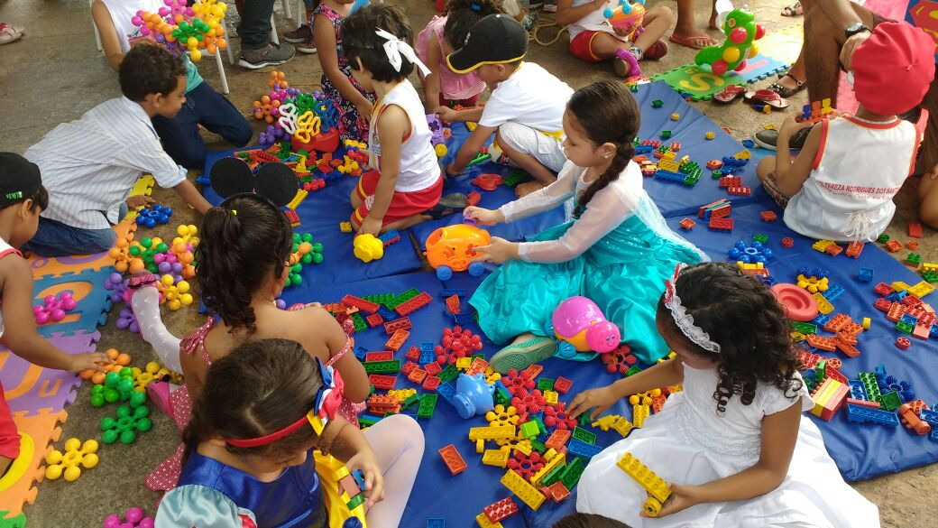
Thank you!
Alaka Holla: aholla@worldbank.org
Yilin Pan: ypan@worldbank.org

